Slide 1
Genome Editing: Past, Present and Future
Peiyu Liu
Notes:
主讲人信息

Slide 2
Outline
Introduction
Genome Editing before CRISPR-Cas
ZFN&TALEN
CRISPR-Cas Immune System
Introduction
Classification
Mechanism
CRISPR-Cas-derived Genome Editing
Nucleases
Base editors
Transposases
Prime editors
Summary

Slide 3
Introduction

Slide 4
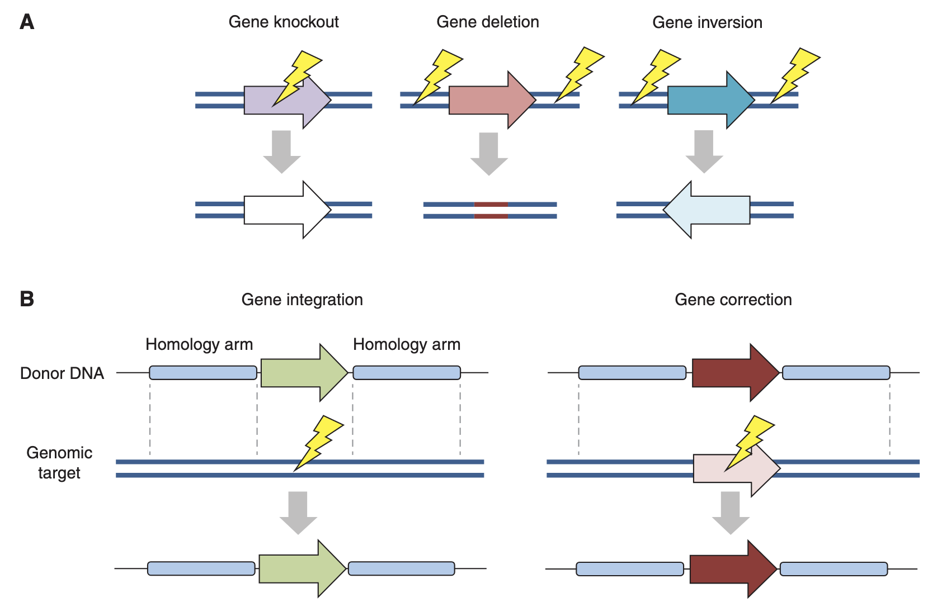
Genome Editing: Basics
Goals
High precision: all sites edited are targeted sites
High recall: all targeted sites are edited
Simple, versatile and cheap to apply
Methods
Zinc-finger nucleases (ZFN)
Transcription activator-like effector nucleases (TALENs)
CRISPR-Cas
Possible outcomes
DSB-induced NHEJ
DSB-induced HDR
Other non-DSB-induced outcomes (e.g., base editing)
DSB-induced genome-editing outcomes.
Indels and inversion introduced by NHEJ in the absence of a homologous donor template DNA.
Recombination introduced by HDR in the presence of the donor DNA.
Lightnings represent DSB sites.
Gaj T, Sirk SJ, Shui SL, Liu J. Genome-Editing Technologies: Principles and Applications. Cold Spring Harb Perspect Biol. 2016 Dec 1;8(12):a023754.

Slide 5
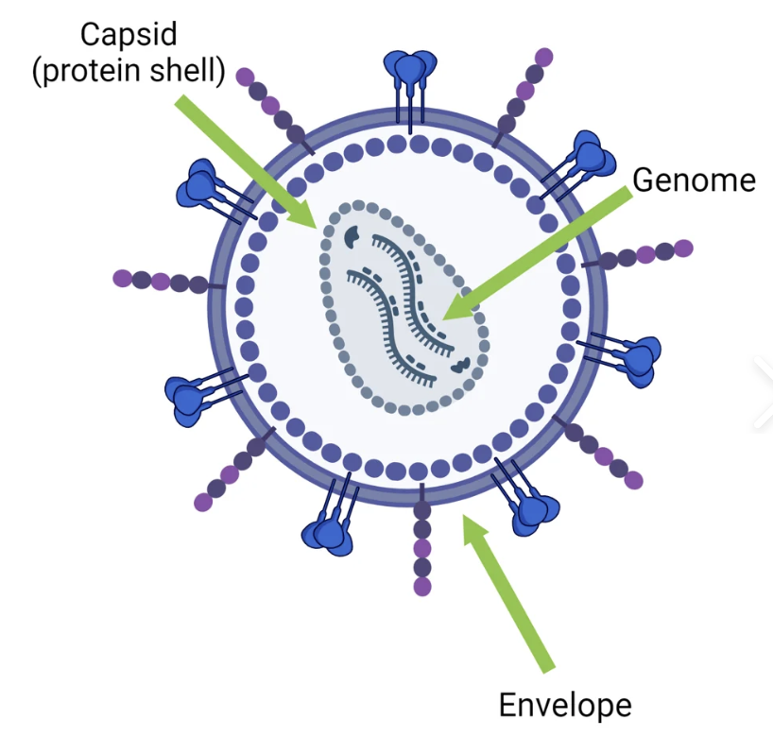
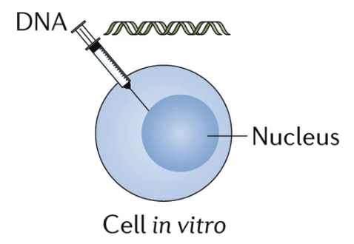
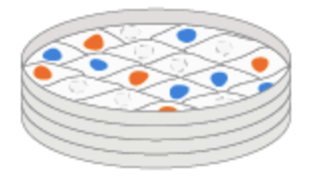
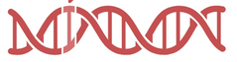
Genome Editing: Workflow
used for research, treatment…
target sequencing
editor design
vector construction
delivery
screen
In practice, many factors need to be considered
Cell line or animal model?
In vivo or in vitro?
Unconditional or conditional?
…
Detailed protocols depend on purposes of genome editing.

Slide 6
Genome Editing before CRISPR-Cas

Slide 7

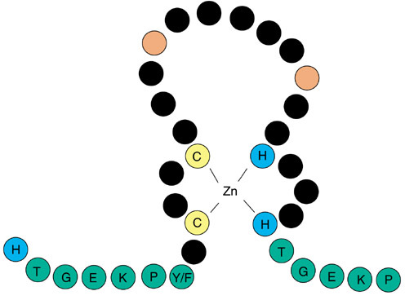
Zinc Finger Nucleases (ZFN)
FokI
: non-specific nuclease domain of FokI restriction enzyme, function as dimer
F
: specific DNA-binding domain, one zinc finger domain of zinc finger proteins
linker
FokI
F
F
F
F
5’
FokI
3’
3’
5’
about 30 residues, organized in ββα motif
F
F
F
F
TGEKPYKCPECGKSFSXXXXXXXHQRTH
Cys₂-His₂ zinc finger
XXXXXXX (7 amino acids) recognize and bind to 3 bps of DNA, specifically.
Schematic diagram of ZFN.
Urnov FD, Rebar EJ, Holmes MC, Zhang HS, Gregory PD. Genome editing with engineered zinc finger nucleases. Nat Rev Genet. 2010 Sep;11(9):636-46.
ZFN
TALEN

Slide 8
Problems of ZFN
7 amino acids map to 3 bp (a triplet) of DNA
# of possible arrangements of triplets: 4³ = 64
# of possible arrangements of amino acids: 20⁷
Problem #1: high complexity
It could be extremely hard to select 64 correct arangements from 20⁷ options.
In fact, it remains challenging to create zinc-finger domains that can effectively recognize all DNA triplets.
Problem #2: lack of target flexibility
Must find several continue triplets that can be targeted near target sites
Problem #3: difficult and expensive to construct zinc-finger arrays
Also time-consuming
ZFN
TALEN

Slide 9
Transcription Activator-like Effector Nucleases (TALENs)
FokI
: non-specific nuclease domain of FokI restriction enzyme, function as dimers
: specific DNA-binding domain of TAL effector
about 34 residues
position 12&13 recognize and bind to 1 bp of DNA, specifically.
Repeat variable diresidues (RVDs)
FokI
NG: T
5’
FokI
3’
3’
5’
NI: A
HD: C
C-terminal domain
N-terminal domain
NH: G
Schematic diagram of TALEN.
Gaj T, Sirk SJ, Shui SL, Liu J. Genome-Editing Technologies: Principles and Applications. Cold Spring Harb Perspect Biol. 2016 Dec 1;8(12):a023754.
ZFN
TALEN

Slide 10
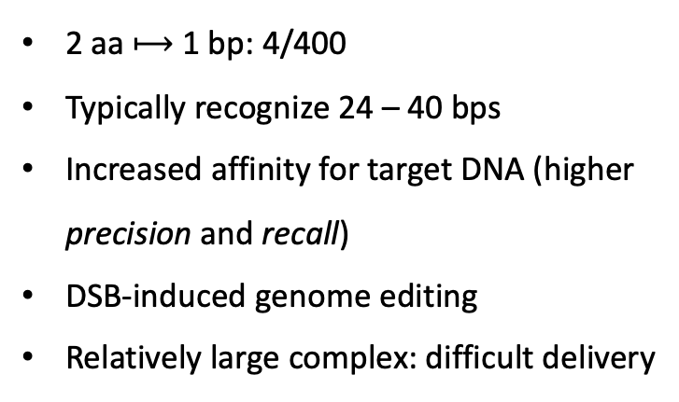
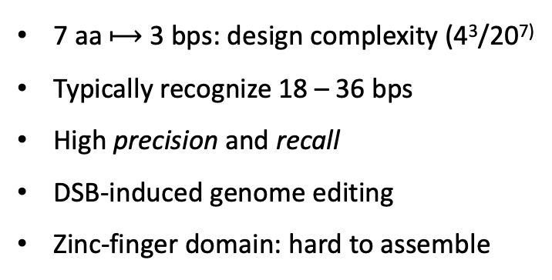
Summary: Protein-guided Nucleases
7 aa $⟼$ 3 bps: design complexity (4³/20⁷⁾
Typically recognize 18 – 36 bps
High precision and recall
DSB-induced genome editing
Zinc-finger domain: hard to assemble
FokI
F
F
F
F
5’
FokI
3’
3’
5’
F
F
F
F
ZFN
2 aa $⟼$ 1 bp: 4/400
Typically recognize 24 – 40 bps
Increased affinity for target DNA (higher precision and recall)
DSB-induced genome editing
Relatively large complex: difficult delivery
FokI
5’
FokI
3’
3’
5’
TALEN
C-terminal domain
N-terminal domain
Gaj T, Sirk SJ, Shui SL, Liu J. Genome-Editing Technologies: Principles and Applications. Cold Spring Harb Perspect Biol. 2016 Dec 1;8(12):a023754.

Slide 11
CRISPR-Cas Immune System

Slide 12
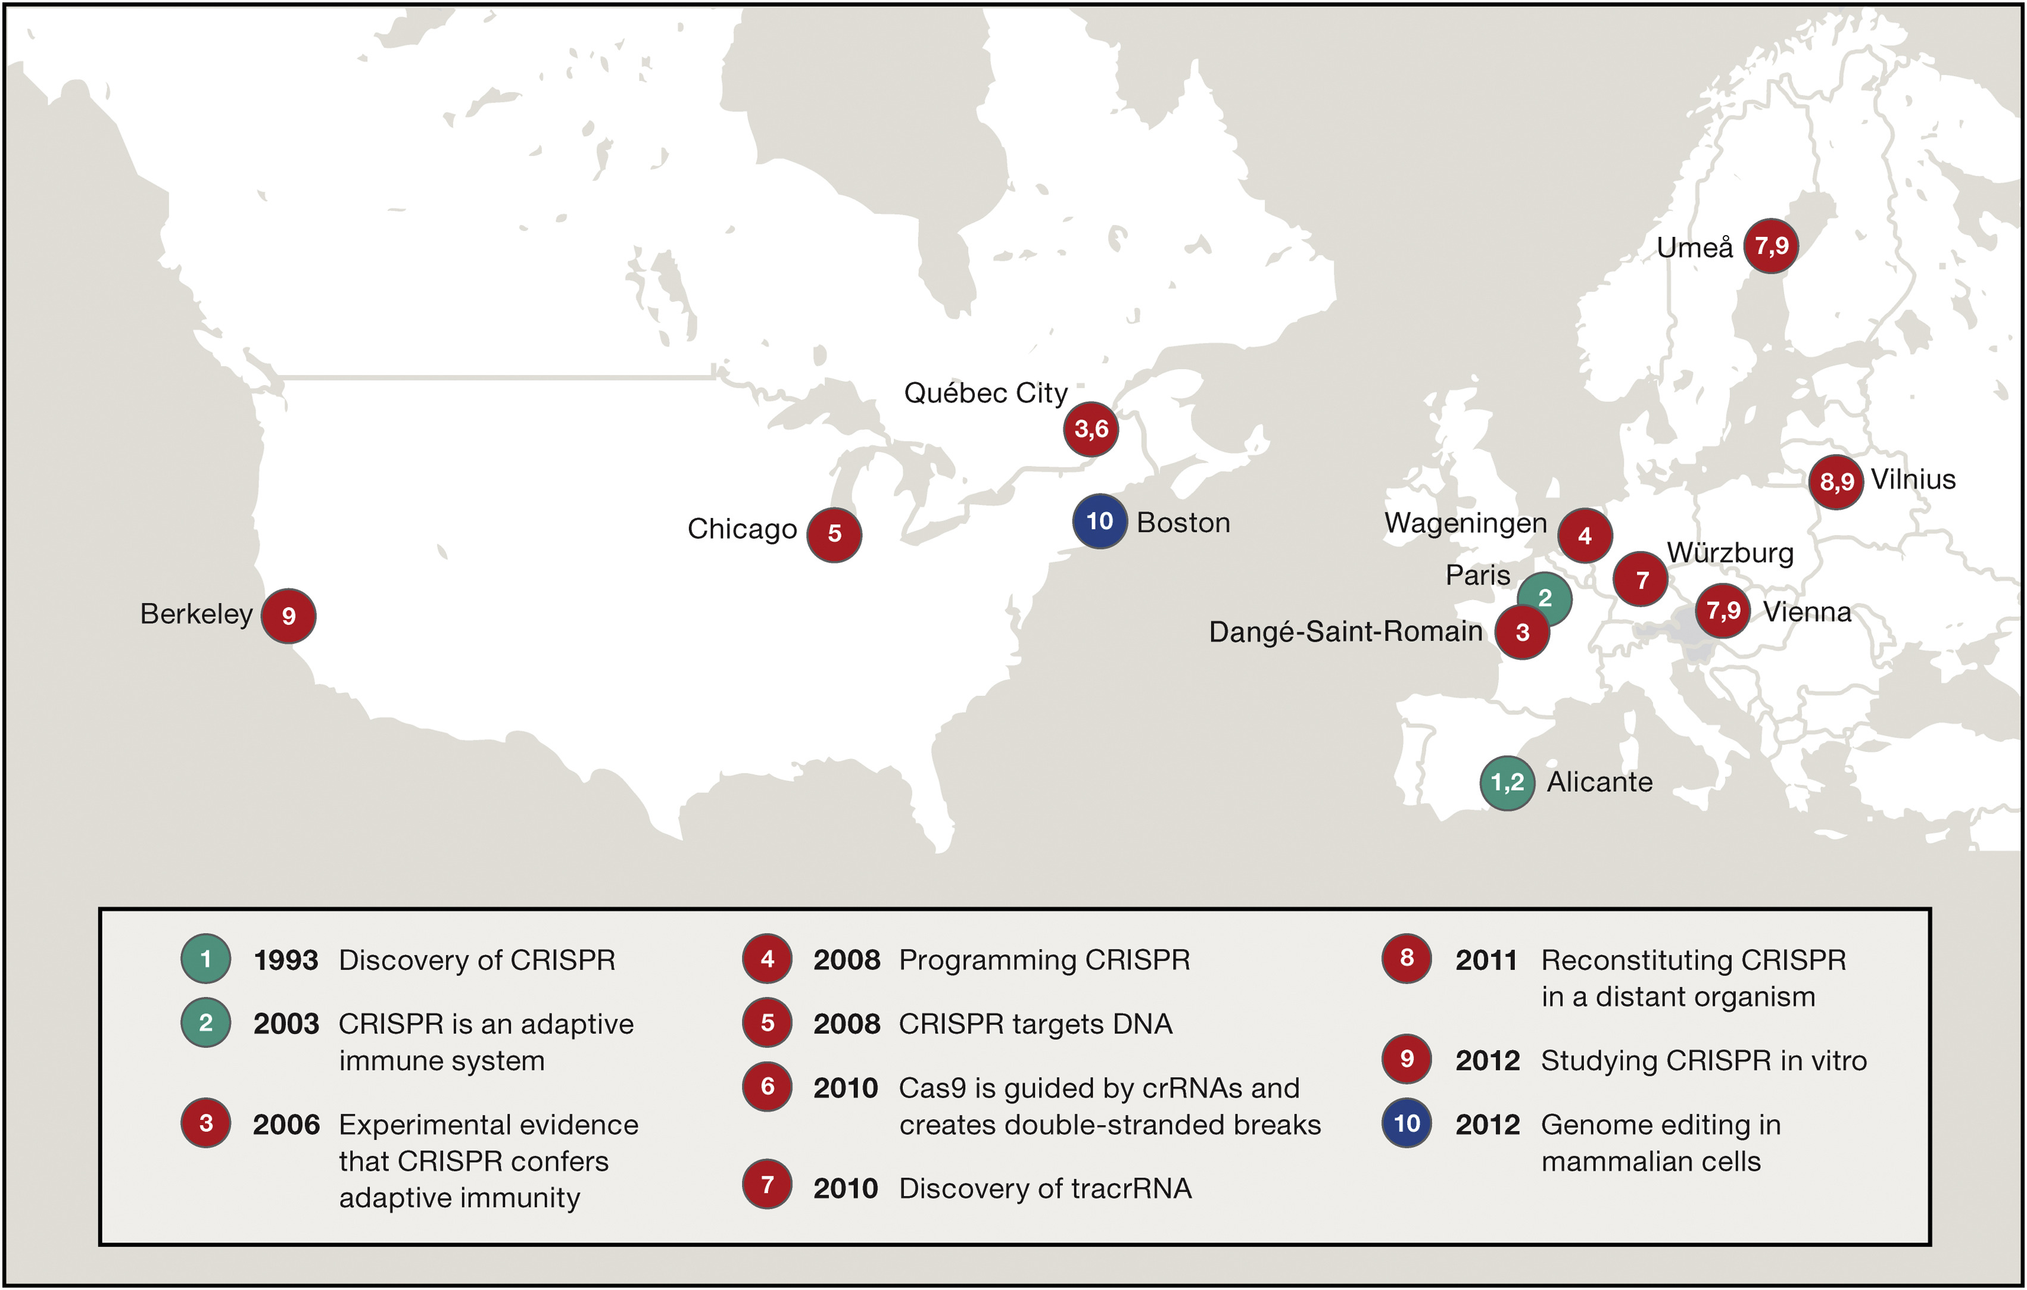
Long Story Short
1987: The first description of CRISPR loci.
1993: Repeated sequences separated by spacers were observed in Haloferax mediterranei.
2002: CRISPR got its name - Clustered Regularly Interspaced Short Palindromic Repeats.
2003/2005: One spacer in E. coli was found to match the sequence of a P1 phage.
2006: Experiments showed that Cas9 was necessary for phage resistance in S. thermophilus.
2008: First artificial CRISPR arrays were performed in E. coli.
The Twenty-Year Story of CRISPR Unfolded across Twelve Cities in Nine Countries
Lander ES. The Heroes of CRISPR. Cell. 2016 Jan 14;164(1-2):18-28.
Introduction
Classification
Mechanism

Slide 13
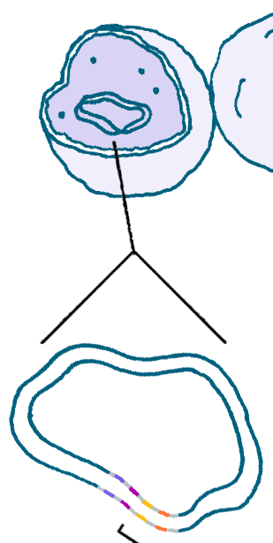

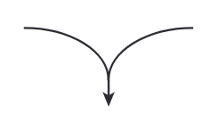
Components of CRISPR-Cas
CRISPR loci
bacteria/archaea
CRISPR-associated (cas) genes
repeats
L
1
2
3
4
5
leader
spacers
genome
pre-crRNA
Cas
complex
crRNA
DNA cleavage
Marraffini LA. CRISPR-Cas immunity in prokaryotes. Nature. 2015 Oct 1;526(7571):55-61.
Introduction
Classification
Mechanism

Slide 14
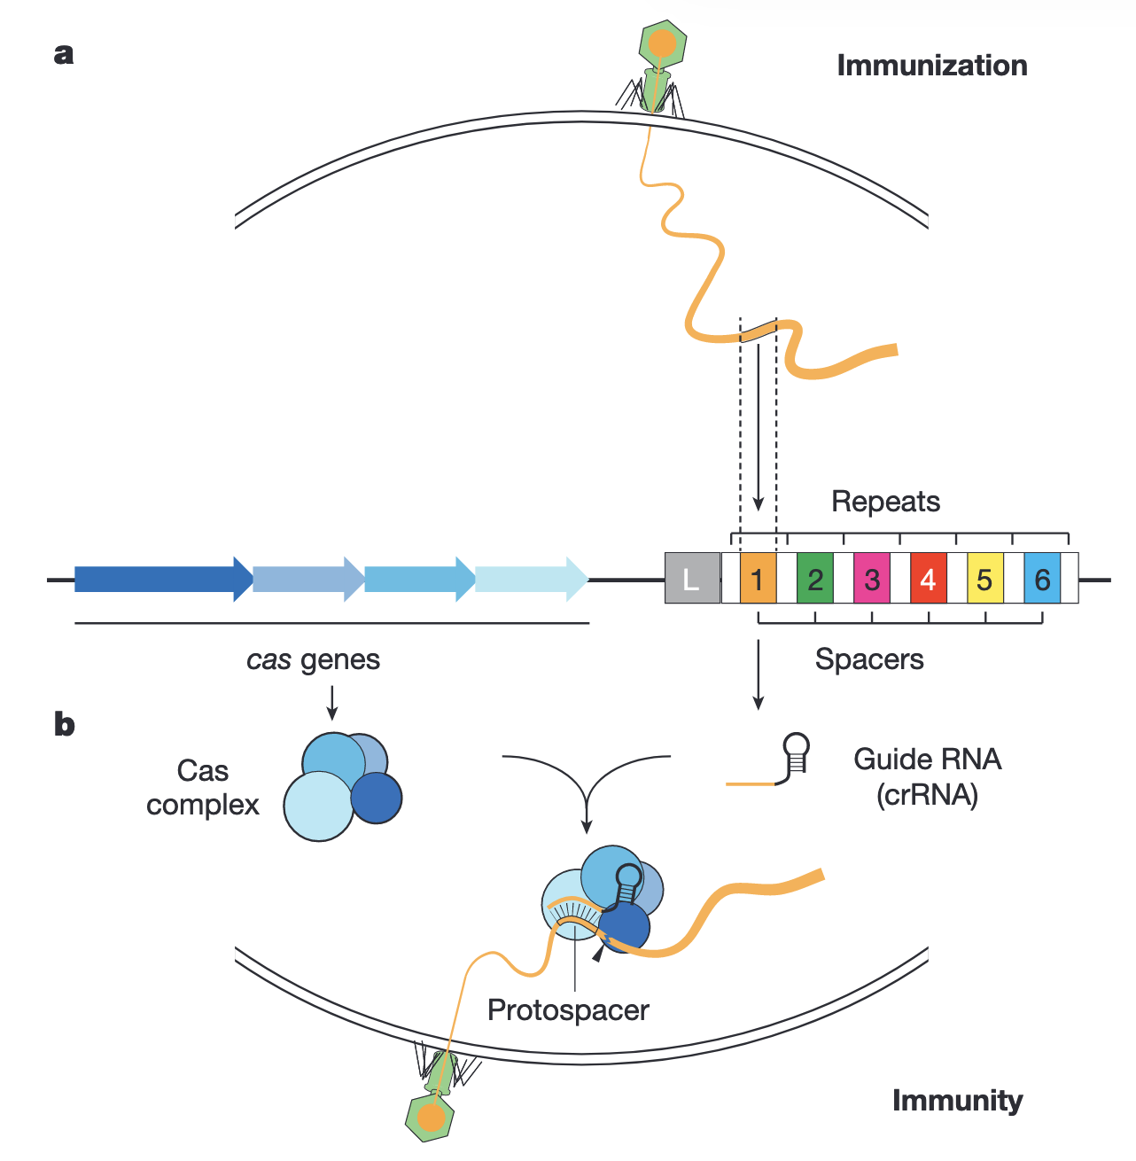
CRISPR-Cas as an Inheritable and Adaptive Immune System
Invading DNA (plasmid, phage genome…)
Marraffini LA. CRISPR-Cas immunity in prokaryotes. Nature. 2015 Oct 1;526(7571):55-61.
Introduction
Composition
Mechanism

Slide 15
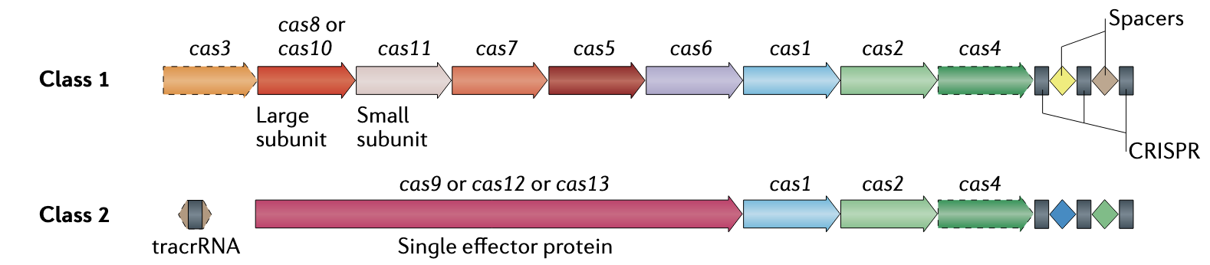
Classification of CRISPR-Cas
2 classes
Class 1: Multiple Cas proteins form a crRNA-binding complex and function together in binding and processing of the target DNA.
Class 2: A single, multidomain tracrRNA:crRNA-binding protein that is functionally analogous to the entire effector complex of class 1.
Makarova et al. Evolutionary classification of CRISPR-Cas systems: a burst of class 2 and derived variants. Nat Rev Microbiol. 2020 Feb;18(2):67-83.
Introduction
Classification
Mechanism
Notes:
Makarova KS, Wolf YI, Iranzo J, Shmakov SA, Alkhnbashi OS, Brouns SJJ, Charpentier E, Cheng D, Haft DH, Horvath P, Moineau S, Mojica FJM, Scott D, Shah SA, Siksnys V, Terns MP, Venclovas Č, White MF, Yakunin AF, Yan W, Zhang F, Garrett RA, Backofen R, van der Oost J, Barrangou R, Koonin EV. Evolutionary classification of CRISPR-Cas systems: a burst of class 2 and derived variants. Nat Rev Microbiol. 2020 Feb;18(2):67-83. doi: 10.1038/s41579-019-0299-x. Epub 2019 Dec 19. PMID: 31857715; PMCID: PMC8905525.

Slide 16
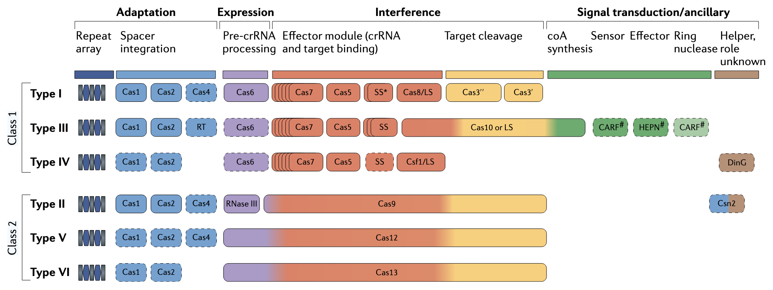
Classification of CRISPR-Cas
2 classes further divide into 6 types
Next, we focus on Type I and II (i.e., CRISPR-Cas9) to see how typical Cas protein(s) function together with crRNA to cleave DNA.
Makarova et al. Evolutionary classification of CRISPR-Cas systems: a burst of class 2 and derived variants. Nat Rev Microbiol. 2020 Feb;18(2):67-83.
Introduction
Classification
Mechanism

Slide 17
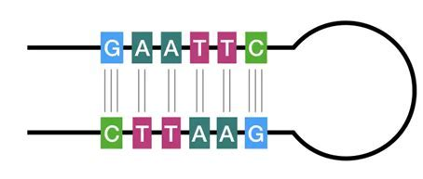
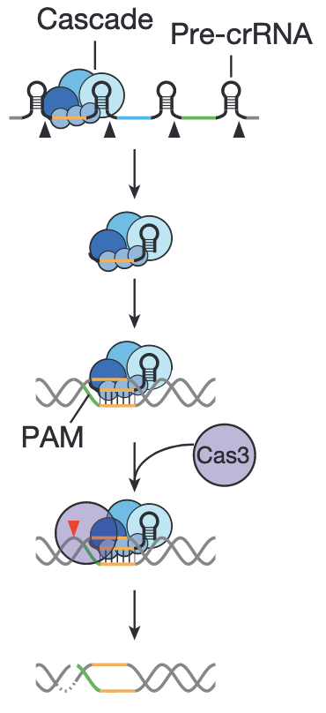
Type I CRISPR-Cas
Pre-crRNA forms stem-loop structures - due to palindromic repeats
Cas complex (namely Cascade) cleaves at the base of each stem-loop
Producing short crRNAs associated with Cascade
Cas-crRNA complex scans DNAs to find the sequence (protospacer) matching the crRNA
Cascade also needs to recognize a short sequence motif located immediately upstream of the protospacer recognized by the crRNA
This short sequence motif is called protospacer adjacent motif (PAM)
Two-factor authentication
Cascade binds to the target
Annealing of the crRNA to the target strand forms an R-loop in non-target strand
Cas3 nuclease is recruited and cleaves single strand of the target
R-loop
Marraffini LA. CRISPR-Cas immunity in prokaryotes. Nature. 2015 Oct 1;526(7571):55-61.
Introduction
Composition
Mechanism

Slide 18
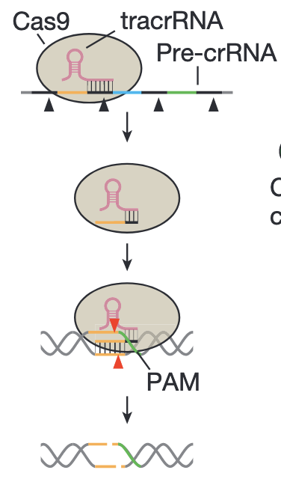
Type II CRISPR-Cas
Cas9 cleavage of Pre-crRNA does not rely on stem-loops
Trans-activating crRNA (tracrRNA) links Cas9 and pre-crRNA
dsRNA is cleaved by RNase III in the presence of Cas9
Producing short crRNAs associated with Cas9
Cas9-tracrRNA:crRNA complex scans DNAs to find the protospacer matching the crRNA
Cas9 recognizes PAM immediately downstream of the protospacer
Cas9 binds to the target
Annealing of the crRNA to the target strand forms an R-loop
Cas9 undergoes conformational changes that result in activation of its nuclease domains
Nuclease domain of Cas9 cleaves double strands of the target in the presence of Mg²⁺
R-loop
Marraffini LA. CRISPR-Cas immunity in prokaryotes. Nature. 2015 Oct 1;526(7571):55-61.
Introduction
Composition
Mechanism
Notes:
video

Slide 19
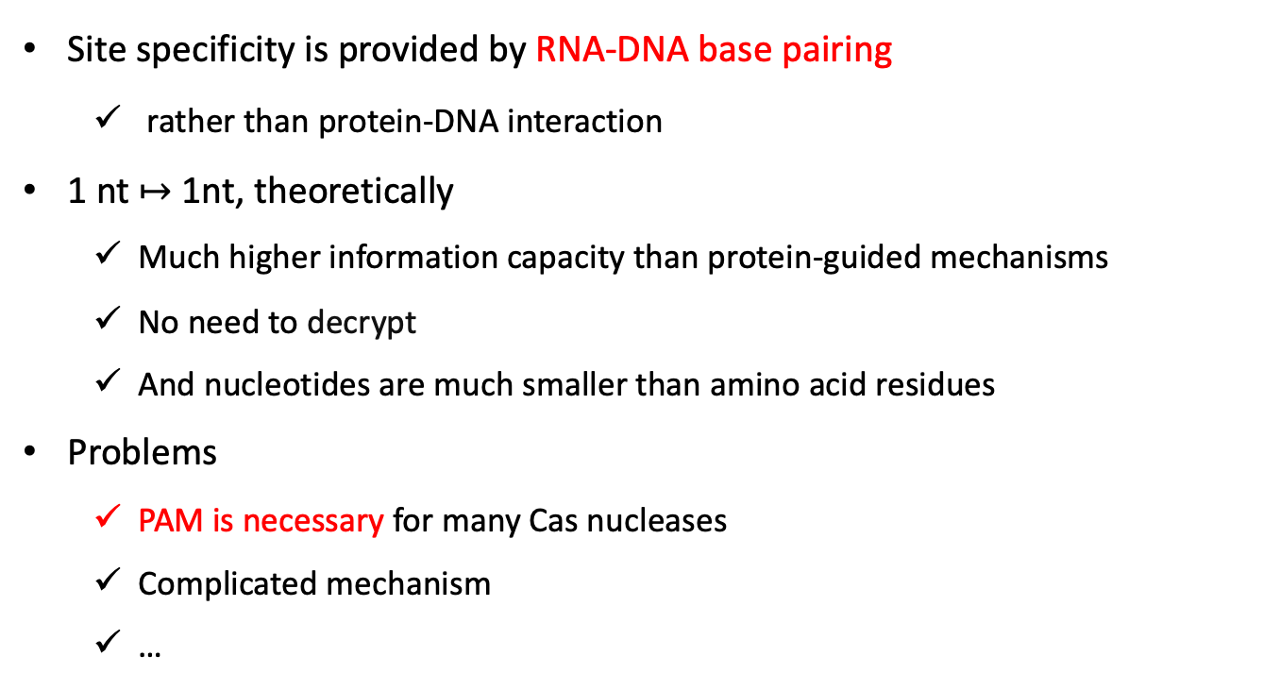
Summary: RNA-guided Nucleases
Site specificity is provided by RNA-DNA base pairing
rather than protein-DNA interaction
1 nt $↦$ 1nt, theoretically
Much higher information capacity than protein-guided mechanisms
No need to decrypt
And nucleotides are much smaller than amino acid residues
Problems
PAM is necessary for many Cas nucleases
Complicated mechanism
…
Introduction
Composition
Mechanism

Slide 20
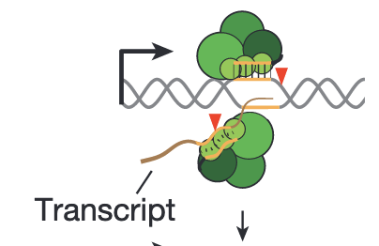
Aside: Seed Sequence and PAM
Seed Sequence: short, highly conserved sequence in the crRNA/protospacer , critical for the crRNA recognition and binding of the target DNA sequence.
PAM: short, conserved sequence in target DNA required for Cas recognition.
Only exist next to the protospacer
Usually 3 bases for Cas9, e.g. 5’-NGG-3’ for SpCas9 (most widely used Cas9 discovered in Streptococcus pyogenes)
Two-factor authentication to avoid auto-immunity
Type I: crRNA and Cascade recognize the complementary strand of DNA
Type II: crRNA and Cas9 recognize complementary and non-complementary strands of DNA, respectively
(Type III Cas does not rely on PAM, instead relies on differential base pairing between crRNA tag and the target sequence)
Marraffini LA. CRISPR-Cas immunity in prokaryotes. Nature. 2015 Oct 1;526(7571):55-61.
Introduction
Composition
Mechanism

Slide 21
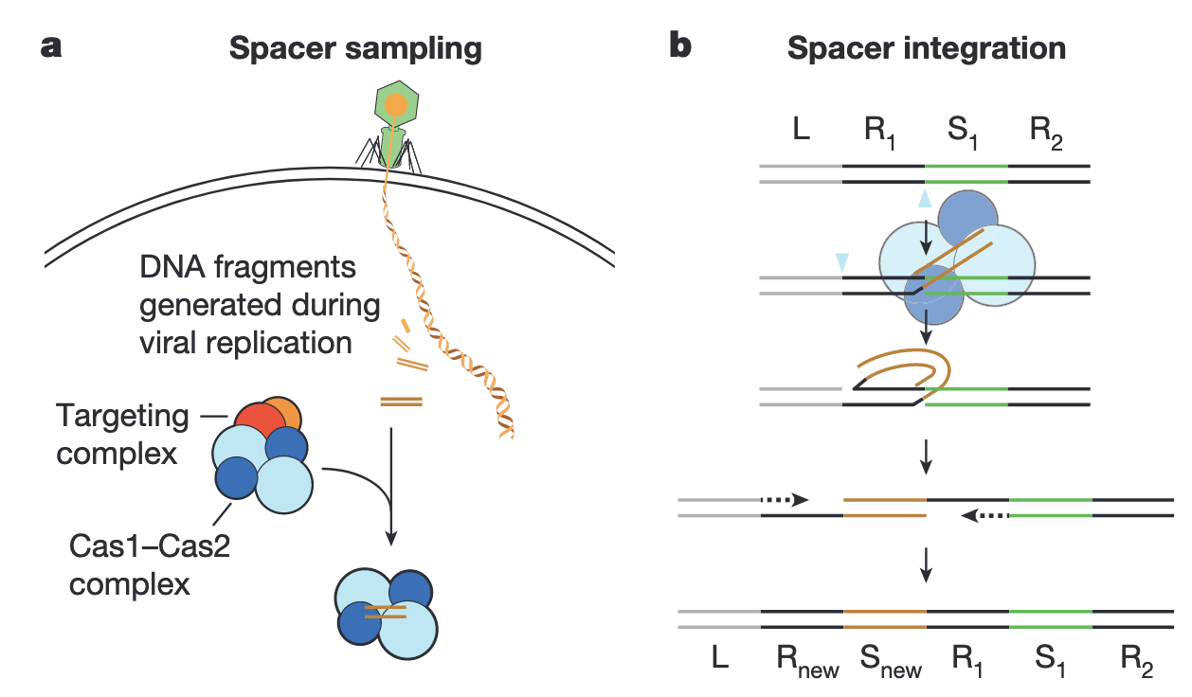
Aside: CRISPR-Cas Immunization
Spacer sampling
Cas1&2 are involved
PAM (e.g., NGG) must be near the protospacer
Spacer integration
A reaction that resembles retroviral integration
Could be viewed as a type of horizontal gene transfer (HGT)
Why always repeat-spacer-…repeat?
Marraffini LA. CRISPR-Cas immunity in prokaryotes. Nature. 2015 Oct 1;526(7571):55-61.
Introduction
Composition
Mechanism

Slide 22
CRISPR/Cas-derived Genome Editing

Slide 23
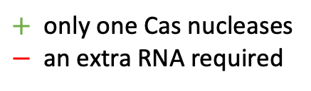
Class 2 CRISPR-Cas for Genome Editing
This is why they need to be engineered.
This is why Class 2 CRISPR-Cas systems are selected to manipulate genome.
Within class 2, Cas9 (Type II) and Cas12 (Type V) are the most widely used nucleases in the context of genome editing.
By default, our discussion below will mainly focus on Cas9, with Cas12 as complement.
$+$ only one Cas nucleases
$−$ an extra RNA required
Makarova et al. Evolutionary classification of CRISPR-Cas systems: a burst of class 2 and derived variants. Nat Rev Microbiol. 2020 Feb;18(2):67-83.

Slide 24

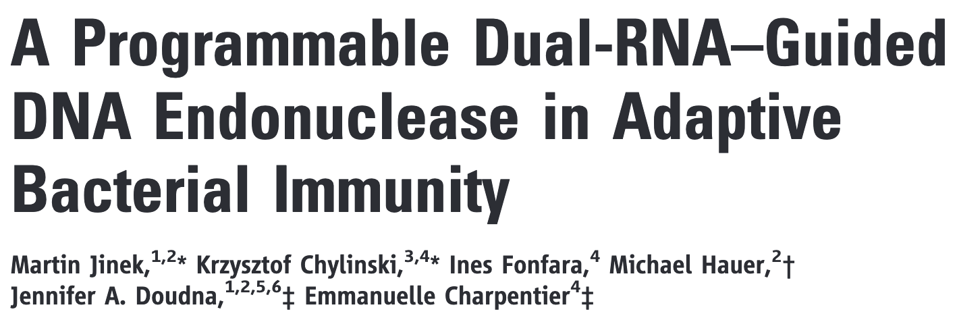
Unlocking the Potential of CRISPR-Cas-based Genome Editing
“The dual-tracrRNA:crRNA, when engineered as a single RNA chimera, also directs sequence-specific Cas9 dsDNA cleavage.”
Nobel Prize in Chemistry 2020
“for the development of a method for genome editing”
Jinek et al. A programmable dual-RNA-guided DNA endonuclease in adaptive bacterial immunity. Science. 2012 Aug 17;337(6096):816-21.

Slide 25
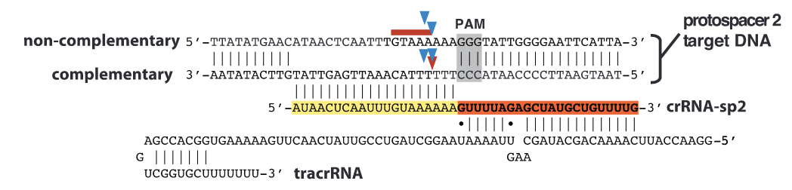
Paper Reading: CRISPR-Cas9 Machinery
At that time, tracrRNA was considered to function only in pre-crRNA processing.
Jinek et al. A programmable dual-RNA-guided DNA endonuclease in adaptive bacterial immunity. Science. 2012 Aug 17;337(6096):816-21.

Slide 26
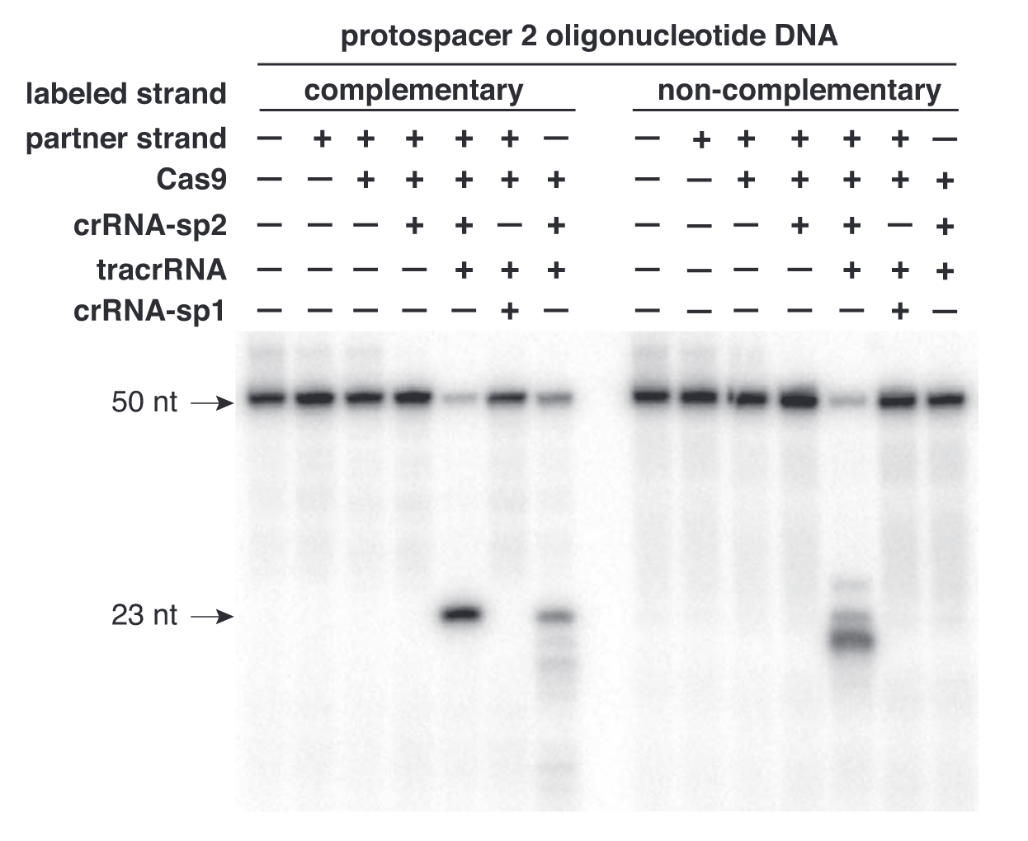
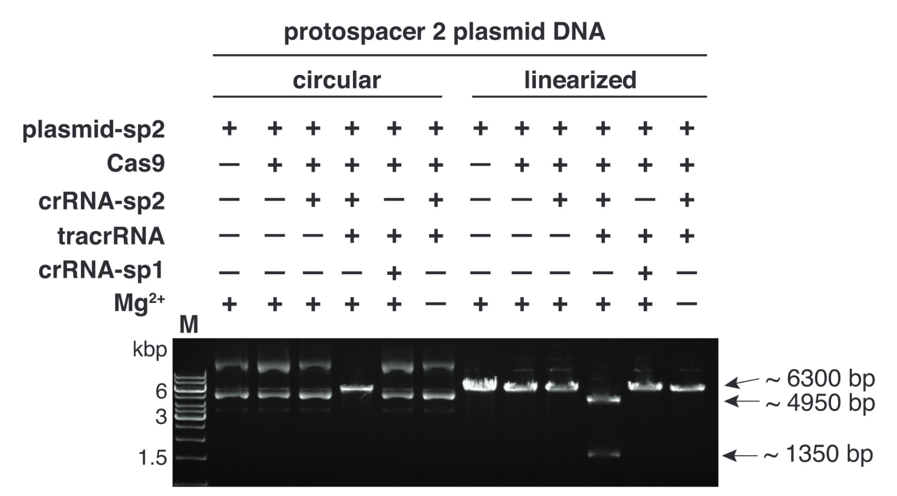
Paper Reading: tracrRNA also functions in DNA cleavage
sp2 + Cas9 + crRNA-sp2 + tracrRNA + Mg²⁺ $⇒$ DNA cleavage
Jinek et al. A programmable dual-RNA-guided DNA endonuclease in adaptive bacterial immunity. Science. 2012 Aug 17;337(6096):816-21.

Slide 27
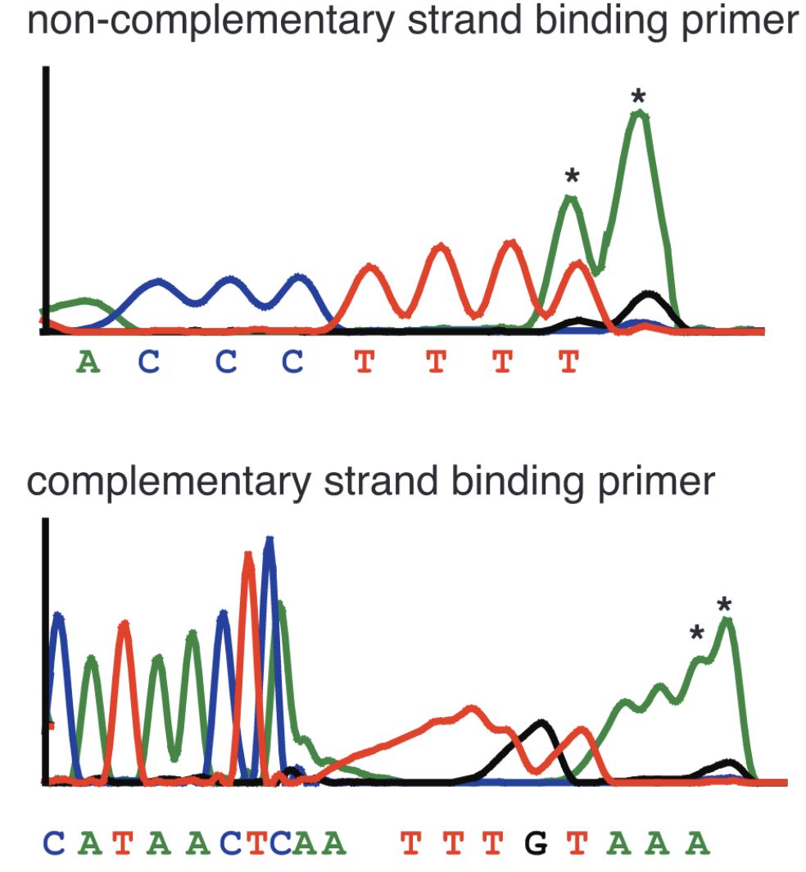
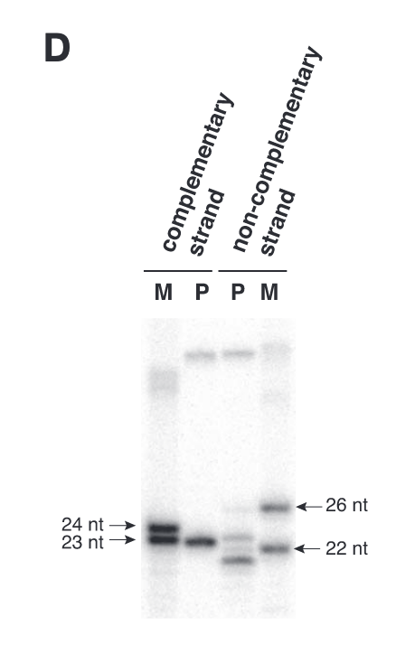
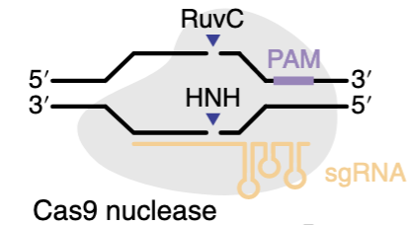
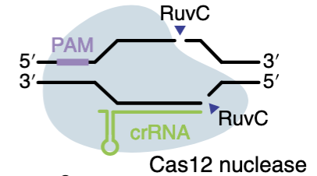
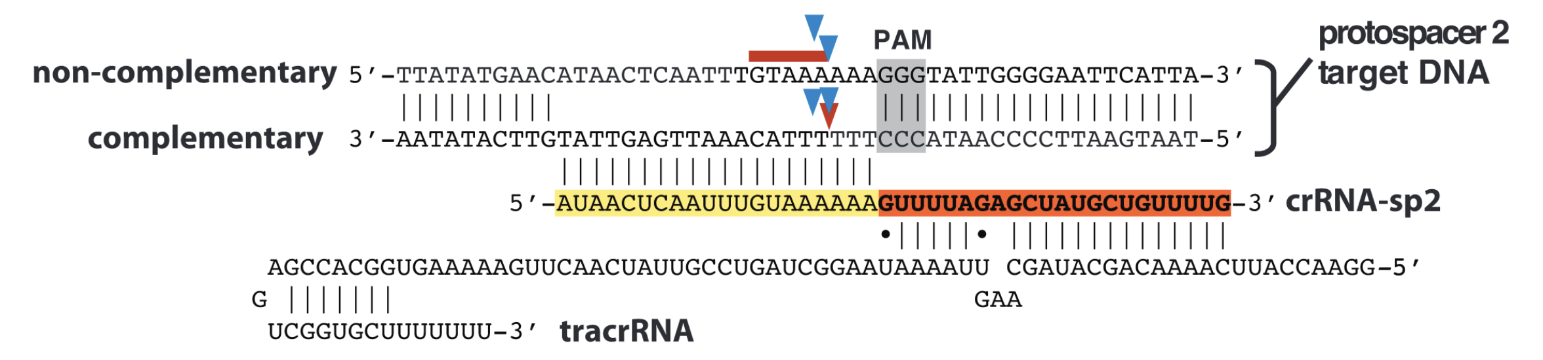
Paper Reading: Site-specific DNA Cleavage
For SpCas9 (used in this research), Cleavage usually occurs at 3 nt upstream of the NGG PAM
For Cas12, it occurs at several nucleotides downstream of the T-rich PAM
fused tracrRNA:crRNA
Many Cas12 nucleases are naturally guided by a single crRNA
Jinek et al. A programmable dual-RNA-guided DNA endonuclease in adaptive bacterial immunity. Science. 2012 Aug 17;337(6096):816-21.

Slide 28
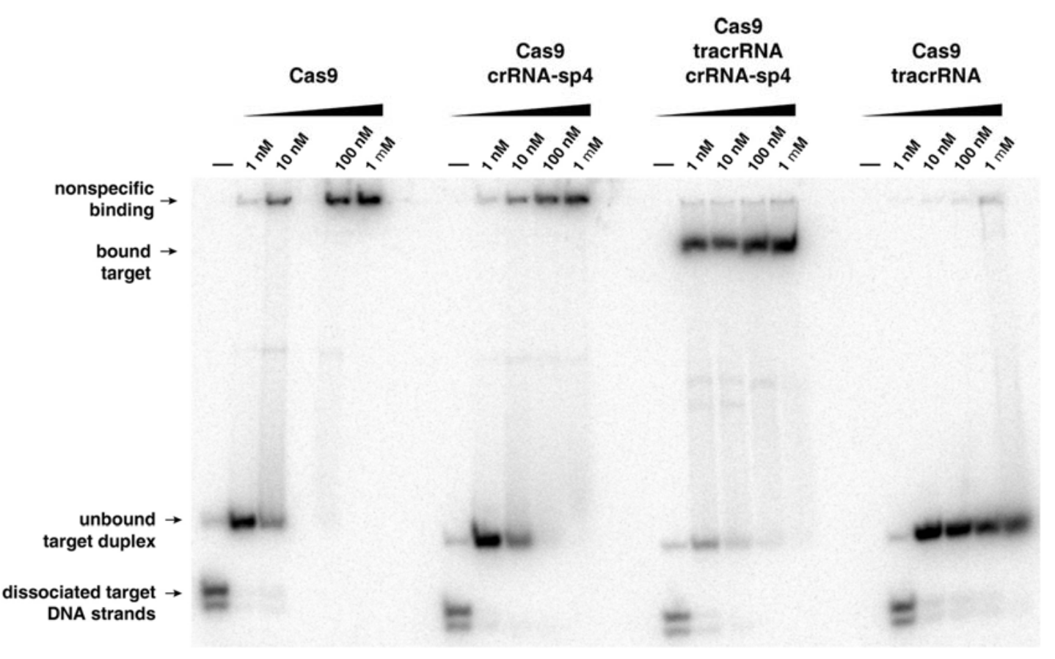
Paper Reading: tracrRNA helps Cas9 recognize targets
Use catalytically dead Cas9 (dCas9)
Cas9 alone binds target DNA with moderate affinity
Unaffected by crRNA, indicating non-specific binding
With tracrRNA alone, Cas9 no longer binds target DNA
With tracrRNA and crRNA, target DNA binding is substantially enhanced
Distinct mobility indicates specific binding
tracrRNA is necessary for Cas9 to recognize target DNA
Jinek et al. A programmable dual-RNA-guided DNA endonuclease in adaptive bacterial immunity. Science. 2012 Aug 17;337(6096):816-21.

Slide 29
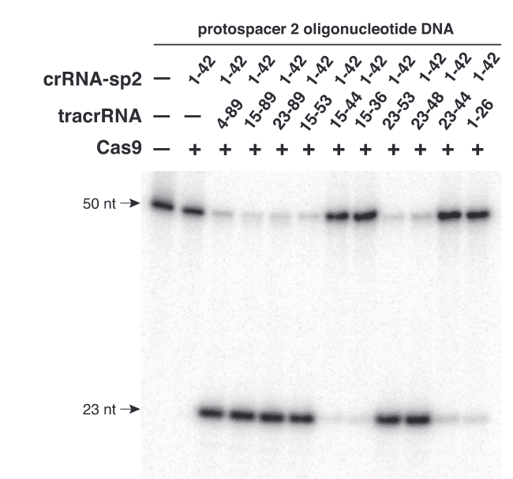
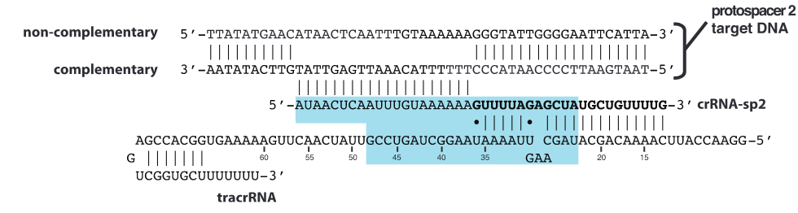
Paper Reading: Part of tracrRNA is enough
Secondary structure of tracrRNA is not that important
Jinek et al. A programmable dual-RNA-guided DNA endonuclease in adaptive bacterial immunity. Science. 2012 Aug 17;337(6096):816-21.

Slide 30
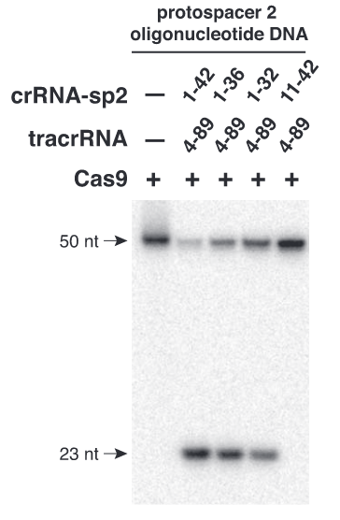
Paper Reading: Same is true for crRNA
A short segment of tracrRNA along with part of crRNA is sufficient for DNA cleavage
Jinek et al. A programmable dual-RNA-guided DNA endonuclease in adaptive bacterial immunity. Science. 2012 Aug 17;337(6096):816-21.

Slide 31
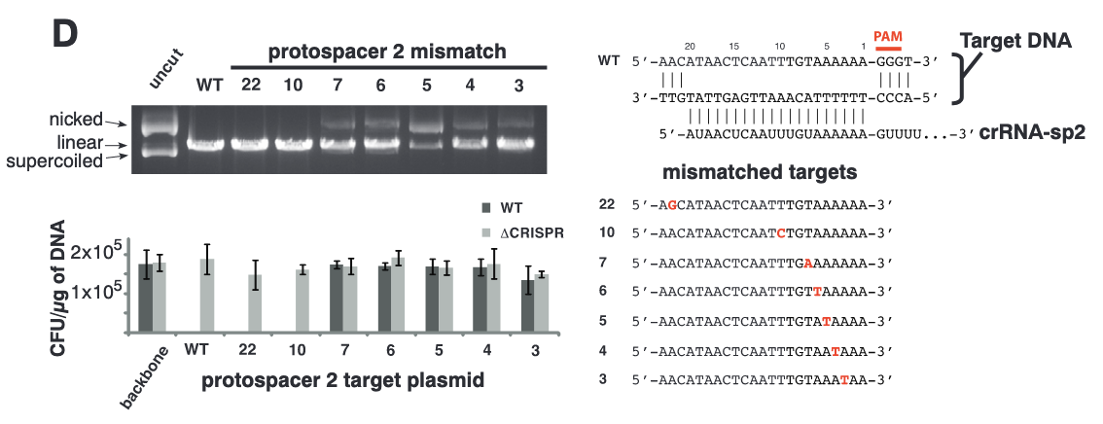
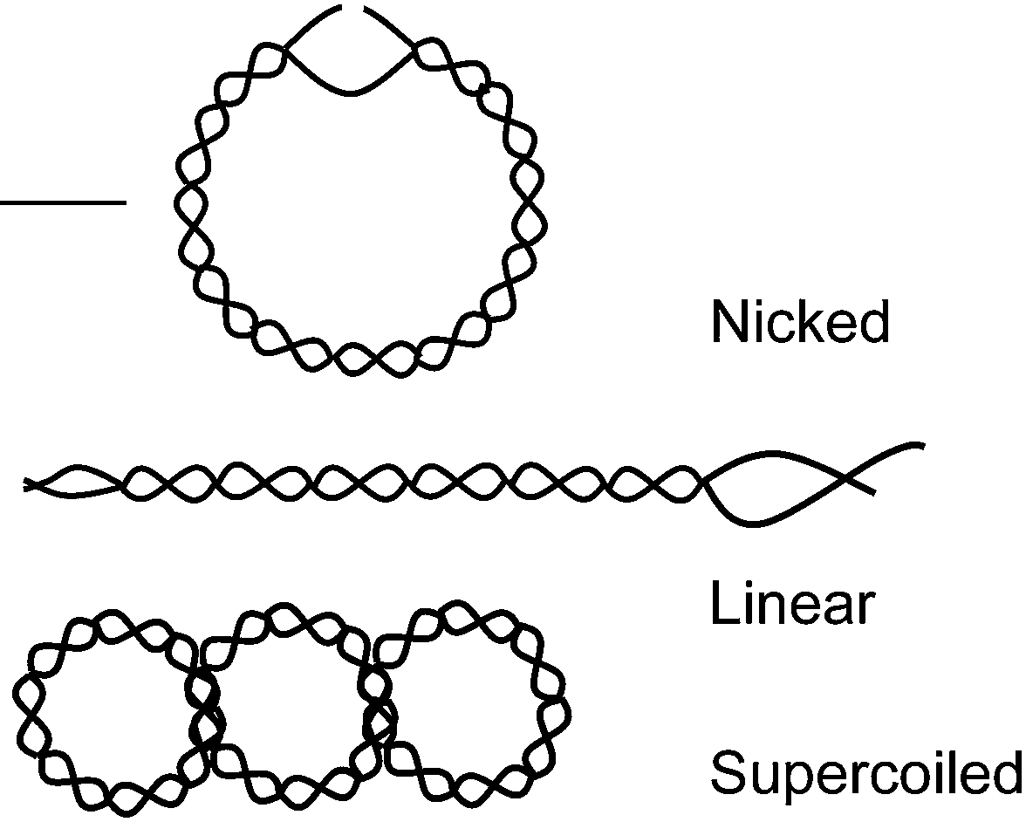
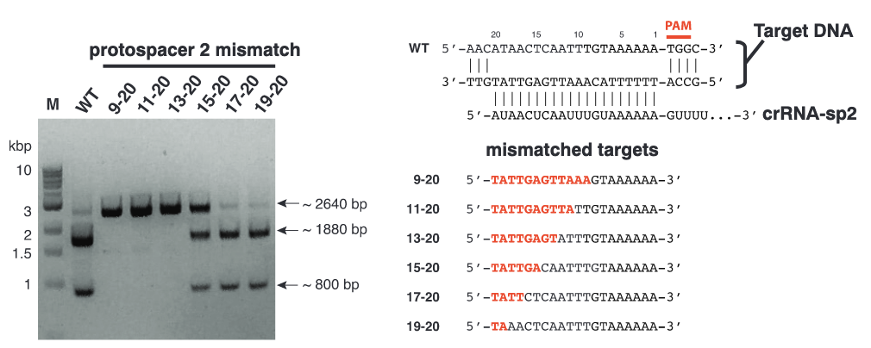
Paper Reading: Also the case for protospacer
Jinek et al. A programmable dual-RNA-guided DNA endonuclease in adaptive bacterial immunity. Science. 2012 Aug 17;337(6096):816-21.
Seed sequence was discovered

Slide 32
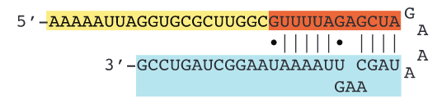
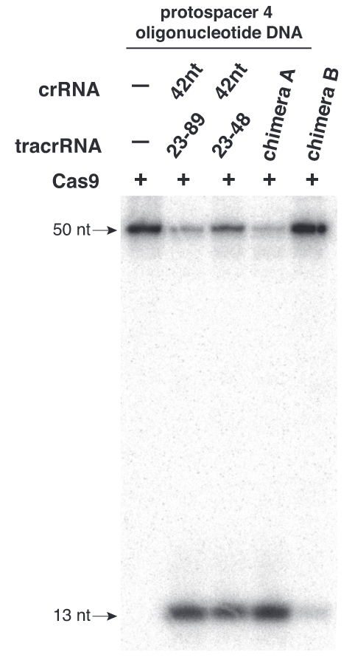
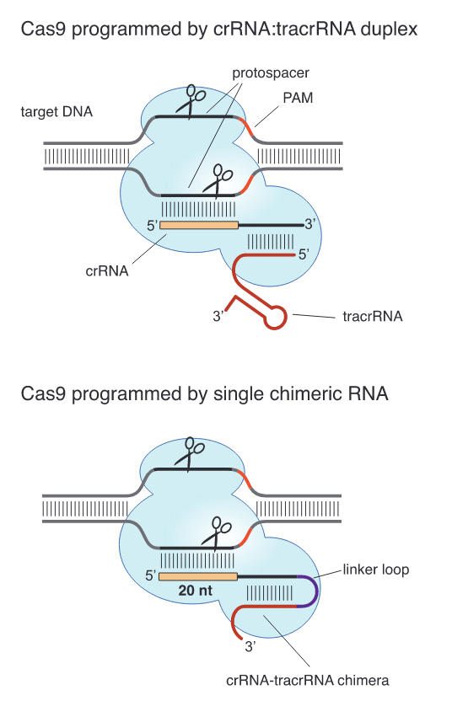
Paper Reading: Engineer CRISPR-Cas9 for Genome Editing
It’s now called single guide RNA (sgRNA)
Jinek et al. A programmable dual-RNA-guided DNA endonuclease in adaptive bacterial immunity. Science. 2012 Aug 17;337(6096):816-21.

Slide 33
They deserve it

Slide 34
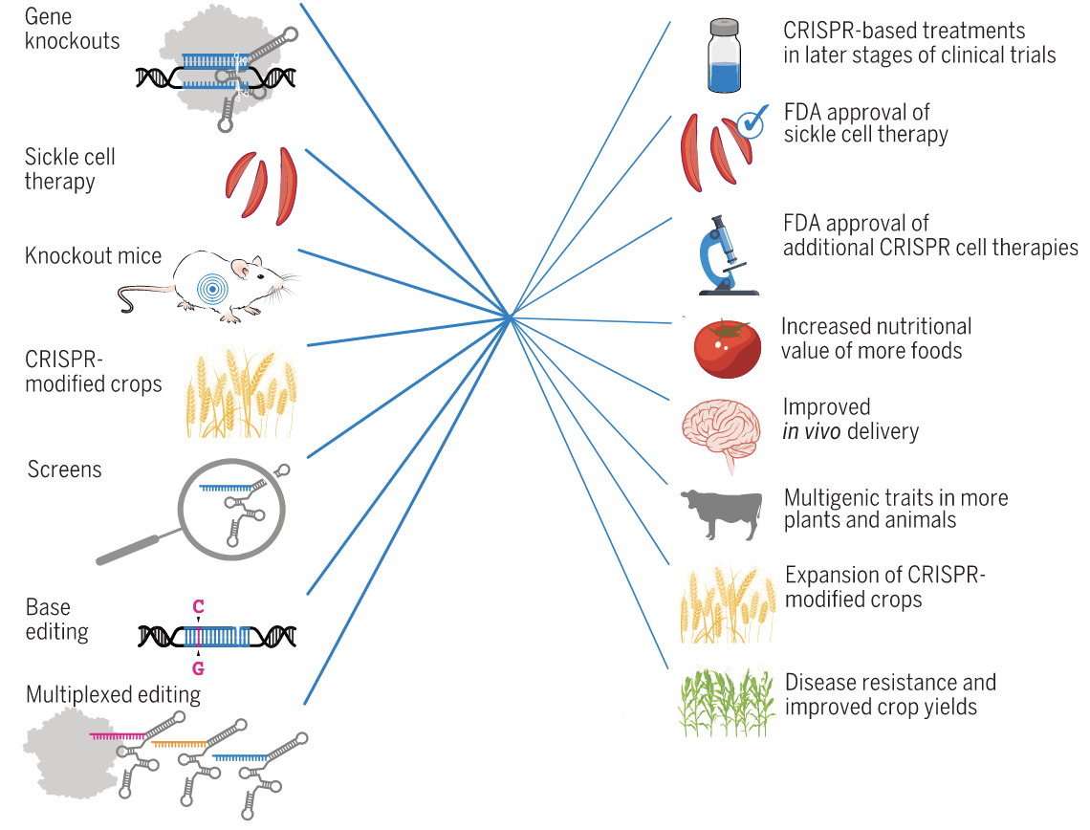
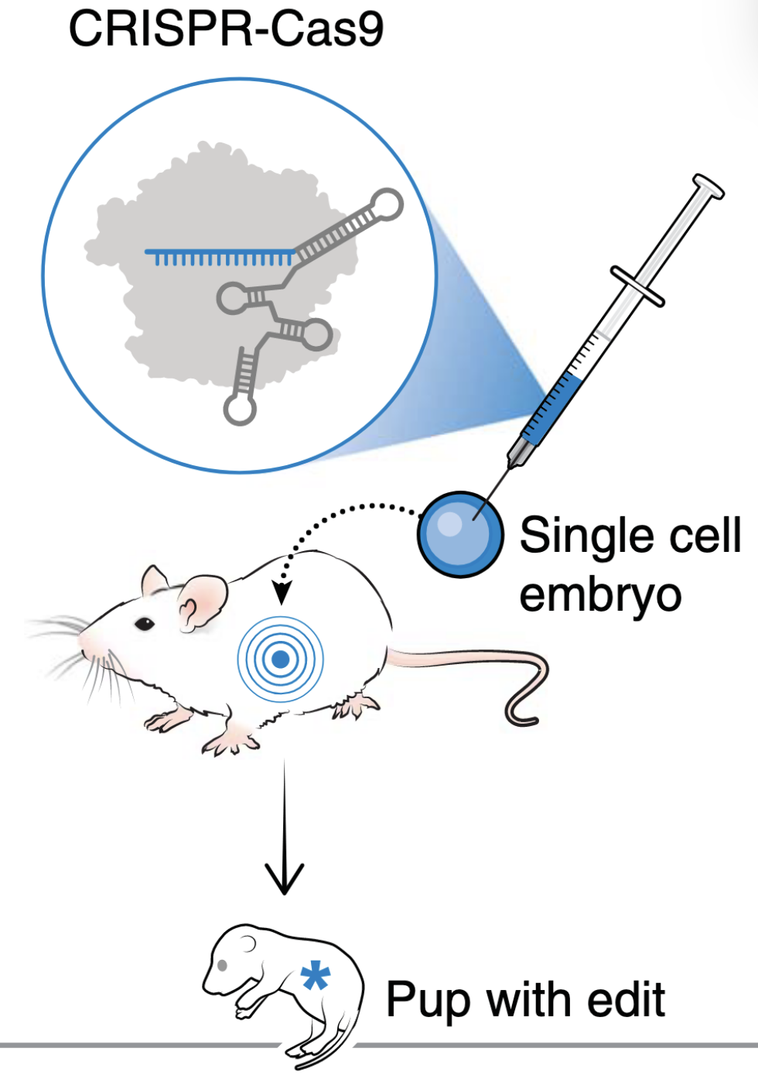
Striking Advantage of CRISPR-Cas
User-friendly and quick creation of KO/transgenetic models
Wang JY, Doudna JA. CRISPR technology: A decade of genome editing is only the beginning. Science. 2023 Jan 20;379(6629):eadd8643.

Slide 35
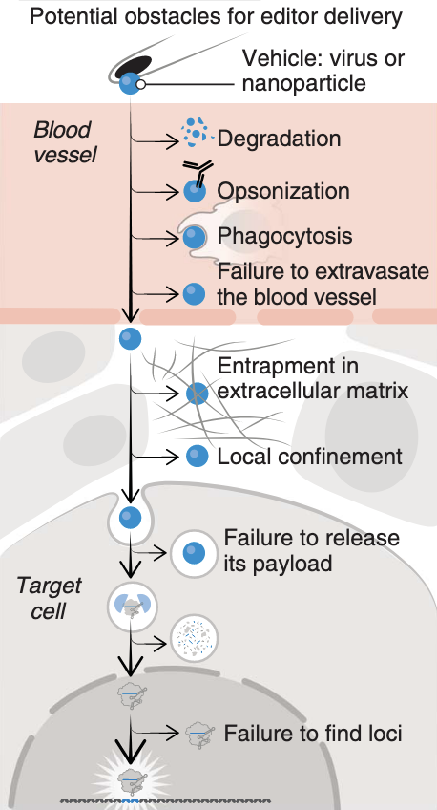
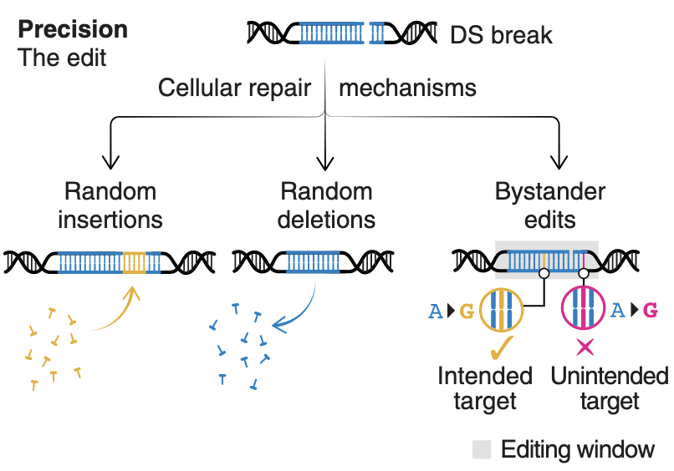
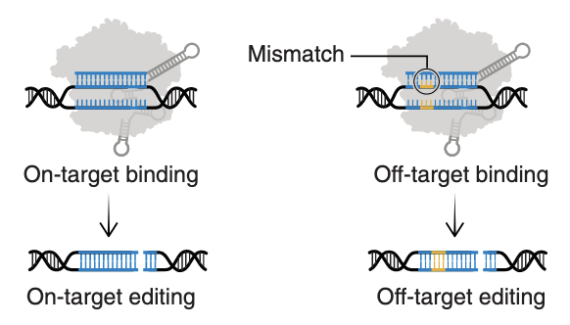
Key Problems of CRISPR-Cas Nucleases
PAM constraint on target scope
Uncertain editing outcomes
Some common issues: delivery, gene integration, ethics & morality…
(Relatively) low specificity
Wang JY, Doudna JA. CRISPR technology: A decade of genome editing is only the beginning. Science. 2023 Jan 20;379(6629):eadd8643.
Notes:
Anzalone, A.V., Koblan, L.W. & Liu, D.R. Genome editing with CRISPR–Cas nucleases, base editors, transposases and prime editors. Nat Biotechnol 38, 824–844 (2020).

Slide 36
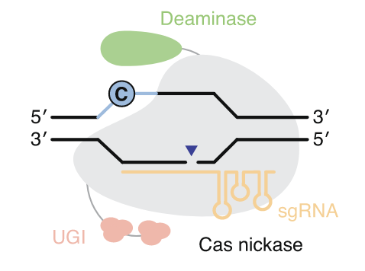
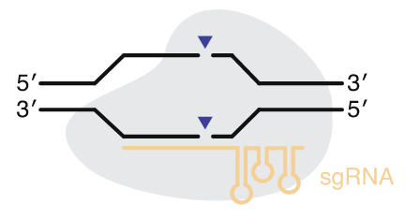
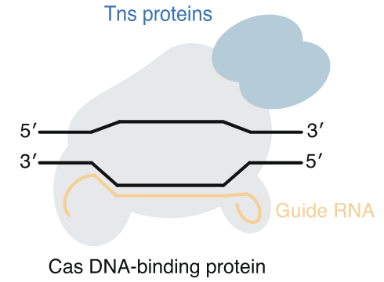
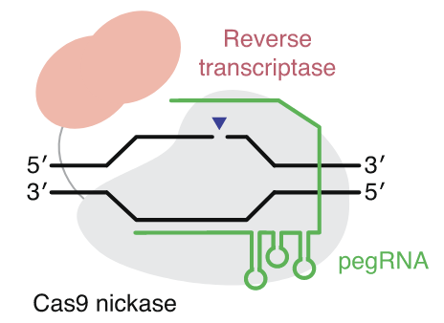
Next: Step-by-step CRISPR-Cas Optimization
General Optimization Goals
More Cas-accessible target sequences
Expand target scope
Base Editors
Nucleases
Enhance fidelity
Less off targets
Transposases
Prime Editor
Anzalone et al. Genome editing with CRISPR-Cas nucleases, base editors, transposases and prime editors. Nat Biotechnol. 2020 Jul;38(7):824-844.
Notes:
Anzalone, A.V., Koblan, L.W. & Liu, D.R. Genome editing with CRISPR–Cas nucleases, base editors, transposases and prime editors. Nat Biotechnol 38, 824–844 (2020).

Slide 37
Cas variants with expanded target scope
Key: relax the constraint of PAM
Not all target sequences have a PAM nearby
Theoretically, shorter PAM is better (more easily to enumerate all possible PAMs)
Many natural Cas9/12 orthologs recognize diversed PAMs
e.g., SaCas9: NNGRRT
Engineered Cas variants through rational design and/or evolution methods
Result: over half of the PAM sequence space can be recognized
Still not enough
Anzalone et al. Genome editing with CRISPR-Cas nucleases, base editors, transposases and prime editors. Nat Biotechnol. 2020 Jul;38(7):824-844.
Nucleases
Base Editors
Transposases
Prime Editors

Slide 38
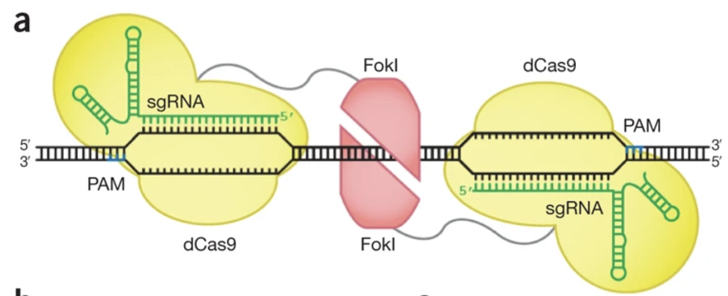


Enhancing Fidelity Externally
Through multiple verifications (at the cost of higher complexity)
Guilinger et al. Fusion of catalytically inactive Cas9 to FokI nuclease improves the specificity of genome modification. Nat Biotechnol. 2014 Jun;32(6):577-582.
Ran et al. Double nicking by RNA-guided CRISPR Cas9 for enhanced genome editing specificity. Cell. 2013 Sep 12;154(6):1380-9.
Bolukbasi et al. Orthogonal Cas9-Cas9 chimeras provide a versatile platform for genome editing. Nat Commun. 2018 Nov 19;9(1):4856.
Nucleases
Base Editors
Transposases
Prime Editors

Slide 39

Enhancing Fidelity Internally
Through interupting non-specific DNA cleavage (at the cost of lower on-target activity)
Slaymaker et al. Rationally engineered Cas9 nucleases with improved specificity. Science. 2016 Jan 1;351(6268):84-8.
Nucleases
Base Editors
Transposases
Prime Editors
Notes:
Slaymaker et al. Rationally engineered Cas9 nucleases with improved specificity. Science. 2016 Jan 1;351(6268):84-8.

Slide 40

Enhancing Fidelity Internally
Through interupting non-specific DNA cleavage (at the cost of limited Cas)
Fu et al. Improving CRISPR-Cas nuclease specificity using truncated guide RNAs. Nat Biotechnol. 2014 Mar;32(3):279-284.
Nucleases
Base Editors
Transposases
Prime Editors
Notes:
Fu et al. Improving CRISPR-Cas nuclease specificity using truncated guide RNAs. Nat Biotechnol. 2014 Mar;32(3):279-284.

Slide 41

Base Editor
Nucleases
Base Editors
Transposases
Prime Editors

Slide 42





Base Editor
Definition
Edit bases of interest without generating DSBs
Motivation
DSB-induced DNA repairs lead to uncertain results
Classification
CBE: C•G to T•A
ABE: A•T to G•C
Basic Principle
Deaminases were connected to Cas nickase (e.g., Cas9n) or dCas (e.g., dCas9)
cytosine
thymidine
adenine
hypoxanthine
guanine
Anzalone et al. Genome editing with CRISPR-Cas nucleases, base editors, transposases and prime editors. Nat Biotechnol. 2020 Jul;38(7):824-844.
Nucleases
Base Editors
Transposases
Prime Editors

Slide 43

Principle
CBE
UNG2
ABE
Anzalone et al. Genome editing with CRISPR-Cas nucleases, base editors, transposases and prime editors. Nat Biotechnol. 2020 Jul;38(7):824-844.
Nucleases
Base Editors
Transposases
Prime Editors

Slide 44
Optimization
Again, expanding target scope
PAM is always a constraint
Modifying R-loop-deaminase interactions
R-loop forms after Cas binds its target and defines where base editing would occur (activity window)
Generally a smaller Cas leads to a larger activity window (e.g., SaCas9, Cas12a vs. SpCas9)
Position and structure of deaminase domain also makes a difference
Minimizing undesired base editing
Transition/transversion
Bystander editing
Indels
Anzalone et al. Genome editing with CRISPR-Cas nucleases, base editors, transposases and prime editors. Nat Biotechnol. 2020 Jul;38(7):824-844.
Nucleases
Base Editors
Transposases
Prime Editors

Slide 45

Precision Issue
Wang JY, Doudna JA. CRISPR technology: A decade of genome editing is only the beginning. Science. 2023 Jan 20;379(6629):eadd8643.
Nucleases
Base Editors
Transposases
Prime Editors

Slide 46

Motivation: Difficulty in Gene Integration
Recap: HDR mainly occurs during S/G2 phase
Nuclease- and nickase-mediated gene integration is limited to actively dividing cells
Discovery of CRISPR-associated transposases
Nuclease activity of Cas is not involved
Gaj T, Sirk SJ, Shui SL, Liu J. Genome-Editing Technologies: Principles and Applications. Cold Spring Harb Perspect Biol. 2016 Dec 1;8(12):a023754.
Klompe et al. Transposon-encoded CRISPR-Cas systems direct RNA-guided DNA integration. Nature. 2019 Jul;571(7764):219-225.
Nucleases
Base Editors
Transposases
Prime Editors
Notes:
Klompe et al. Transposon-encoded CRISPR-Cas systems direct RNA-guided DNA integration. Nature. 2019 Jul;571(7764):219-225.

Slide 47


Transposases
Transposon (DNA donor)
Transposase locus
Peters JE, Craig NL. Tn7: smarter than we thought. Nat Rev Mol Cell Biol. 2001 Nov;2(11):806-14.
TnsAB complex catalyzes the excision of transposon
TnsD or TnsE determines target DNA substrate
TnsC is an ATPase
Anzalone et al. Genome editing with CRISPR-Cas nucleases, base editors, transposases and prime editors. Nat Biotechnol. 2020 Jul;38(7):824-844.
Nucleases
Base Editors
Transposases
Prime Editors

Slide 48

CRISPR-associated Transposases
Replace the tnsD or tnsE genes with cas
Target DNA substrate is now determined by Cas-sgRNA
Peters JE, Craig NL. Tn7: smarter than we thought. Nat Rev Mol Cell Biol. 2001 Nov;2(11):806-14.
tnsD homolog
Klompe et al. Transposon-encoded CRISPR-Cas systems direct RNA-guided DNA integration. Nature. 2019 Jul;571(7764):219-225.
Lampe et al. Targeted DNA integration in human cells without double-strand breaks using CRISPR-associated transposases. Nat Biotechnol. 2024 Jan;42(1):87-98.
Nucleases
Base Editors
Transposases
Prime Editors

Slide 49

CRISPR-associated Transposases
Now CRISPR-associated transposases have been successfully applied in mammalian cells
Cons: low efficiency and substantial target sequence restrictions
Lampe et al. Targeted DNA integration in human cells without double-strand breaks using CRISPR-associated transposases. Nat Biotechnol. 2024 Jan;42(1):87-98.
Anzalone et al. Genome editing with CRISPR-Cas nucleases, base editors, transposases and prime editors. Nat Biotechnol. 2020 Jul;38(7):824-844.
Nucleases
Base Editors
Transposases
Prime Editors
Notes:
Lampe et al. Targeted DNA integration in human cells without double-strand breaks using CRISPR-associated transposases. Nat Biotechnol. 2024 Jan;42(1):87-98.

Slide 50

Prime Editors
Motivation: nucleases and BEs are not precise enough to install point mutations
Extend sgRNA and add a reverse transcriptase
primer binding sequence (PBS)
Anzalone et al. Genome editing with CRISPR-Cas nucleases, base editors, transposases and prime editors. Nat Biotechnol. 2020 Jul;38(7):824-844.
Nucleases
Base Editors
Transposases
Prime Editors

Slide 51
Summary

Slide 52
Summary
Protein-guided vs. RNA-guided
ZFN & TALEN vs. CRISPR-Cas
General principle: introduce site-specificity to non-specific molecules
Naturally occurred CRISPR-Cas is an diversed inheritable and adaptive immune system
Key concept: spacer, repeat, protospacer, pre-crRNA, crRNA, tracrRNA, Cas, PAM, seed sequence, R-loop…
Diversity: 2 classes, 6 types
2012 marks the beginning of an era belonging to genome editing
sgRNA simplifies CRISPR-Cas significantly
Many extraordinary researches and figures working on improving CRISPR-Cas genome editing
Improved Nucleases, base editors, transposases, prime editors…
Charpentier, Doudna, David Liu, Feng Zhang…

Slide 53

Wang JY, Doudna JA. CRISPR technology: A decade of genome editing is only the beginning. Science. 2023 Jan 20;379(6629):eadd8643.

Slide 54
Reference
Gaj T, Sirk SJ, Shui SL, Liu J. Genome-Editing Technologies: Principles and Applications. Cold Spring Harb Perspect Biol. 2016 Dec 1;8(12):a023754.
Urnov FD, Rebar EJ, Holmes MC, Zhang HS, Gregory PD. Genome editing with engineered zinc finger nucleases. Nat Rev Genet. 2010 Sep;11(9):636-46.
Lander ES. The Heroes of CRISPR. Cell. 2016 Jan 14;164(1-2):18-28.
Marraffini LA. CRISPR-Cas immunity in prokaryotes. Nature. 2015 Oct 1;526(7571):55-61.
Makarova et al. Evolutionary classification of CRISPR-Cas systems: a burst of class 2 and derived variants. Nat Rev Microbiol. 2020 Feb;18(2):67-83.
Jinek et al. A programmable dual-RNA-guided DNA endonuclease in adaptive bacterial immunity. Science. 2012 Aug 17;337(6096):816-21.
Wang JY, Doudna JA. CRISPR technology: A decade of genome editing is only the beginning. Science. 2023 Jan 20;379(6629):eadd8643.
Anzalone et al. Genome editing with CRISPR-Cas nucleases, base editors, transposases and prime editors. Nat Biotechnol. 2020 Jul;38(7):824-844.

Slide 55
Reference
Ran et al. Double nicking by RNA-guided CRISPR Cas9 for enhanced genome editing specificity. Cell. 2013 Sep 12;154(6):1380-9.
Guilinger et al. Fusion of catalytically inactive Cas9 to FokI nuclease improves the specificity of genome modification. Nat Biotechnol. 2014 Jun;32(6):577-582.
Bolukbasi et al. Orthogonal Cas9-Cas9 chimeras provide a versatile platform for genome editing. Nat Commun. 2018 Nov 19;9(1):4856.
Slaymaker et al. Rationally engineered Cas9 nucleases with improved specificity. Science. 2016 Jan 1;351(6268):84-8.
Fu et al. Improving CRISPR-Cas nuclease specificity using truncated guide RNAs. Nat Biotechnol. 2014 Mar;32(3):279-284.
Klompe et al. Transposon-encoded CRISPR-Cas systems direct RNA-guided DNA integration. Nature. 2019 Jul;571(7764):219-225.
Peters JE, Craig NL. Tn7: smarter than we thought. Nat Rev Mol Cell Biol. 2001 Nov;2(11):806-14.
Lampe et al. Targeted DNA integration in human cells without double-strand breaks using CRISPR-associated transposases. Nat Biotechnol. 2024 Jan;42(1):87-98.

Slide 56

Thank you!

Slide 57
Q&A

Slide 58
Q&A
BE3通过Cas9切口酶活性在非编辑链引入切口，这个切口为什么只激活了错配修复（MMR）而没有激活其他修复途径（如BER或NHEJ）？
CRISPR技术与传统的基因组编辑方法（如锌指核酸酶和TALENs）相比具有哪些优势和局限性？在什么情况下选择CRISPR技术更为合适？
碱基编辑器的活性窗口（activity window）是一个关键参数，设计活性窗口的大小和位置时需要考虑哪些因素？ABEs的编辑窗口集中在protospacer的4-7位，而BE3的窗口更宽。这种差异与哪些因素有关？
ABE7.10在特定位点表现良好，但编辑效率仍会受靶点序列上下游结构、DNA甲基化状态等影响。AlphaFold 等结构预测工具是否可辅助设计ABE靶向区域？
在碱基编辑过程中，如何确保编辑的永久性？
除了文中研究的细胞系，碱基编辑技术在其他细胞类型中的效果如何？是否存在差异？
在碱基编辑过程中，如何避免或减少因多次编辑同一区域而导致的基因组不稳定？
对于具有复杂遗传背景的多基因疾病，碱基编辑技术如何实现多个相关基因突变的同时精准校正？
Cas9蛋白如何在极高的分子噪声中保持精准识别目标序列，从而避免误伤宿主基因组，在这方面还存在哪些尚未解决的机制或者调控因素？

Slide 59
Q&A
辅文献中提到利用决策树的方法指导不同编辑器的选择。在实际应用中，如何综合考量目标位点的序列背景、PAM位置以及编辑器的内在特性，以实现既高效又精准的编辑方案
不同细胞类型对碱基编辑的响应有差异，不同的环境因素是如何影响碱基编辑的？
目前常用的基因编辑方法除了CRISPR-Cas9、base editing，还有prime editing，这几种编辑方法在实际使用中有何优劣？
除了Cas9以外，目前有许多Cas家族或与Cas家族同源的核酸酶如Cas13、CasE、TnpB等也在DNA或RNA编辑中被使用。开发不同类型的核酸酶对于开发基因编辑工具有什么意义？
基于HDR的基因编辑治疗方法疗效低下的原因是什么？
主文献强调不需要DSB就可以进行基因编辑，为什么强调这一点？难道说不使用DSB的基因编辑比使用DSB的更有优势？
当有了成熟的基因编辑技术之后，那剩下的问题就是我们如何知道每个基因（及其等位基因）是干什么的，这样我们就可以把基因按照自己想要的方式进行编辑。那我们如何解决这一问题呢？未来有哪些可能的解决这一问题的方式？

Slide 60


Q&A
Cas9的两个核酸酶结构域HNH和RuvC-like可以分别切割互补链和非互补链，这两类结构域在进化上是否独立起源？
从下面的图看可能是独立起源的？HNH插入到了RuvC中
可能很难确认，因为cas基因大多从转座子演化而来，很难确定这些转座子在演化上的最初来源（可能是某些病毒基因组的片段…）

Slide 61



Q&A
目前碱基编辑技术主要是C到T、A到G的转换，如果想要实现其他转换该如何做？

Slide 62


Q&A
使用非病原性细菌来源的Cas9变体是否能够降低免疫原性，从而更适合体内治疗？
Cas9的免疫原性确实会导致其在体内的基因编辑效率下降
但人体对Cas9的免疫原性高低和其来源的细菌是否致病关系可能不大？
降低对异体蛋白的免疫反应可能是更好的思路

